Slide 1

AT3 (CO1, 10%): Design Trade-offs in Computer Vision System Architecture — A Comparative Application-Domain Presentation
AUTONOMOUS VEHICLE PERCEPTION
Yaswanth
192324179
DSA0205-Computer Vision with Open CV

Slide 2
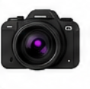

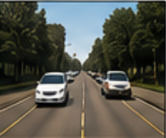
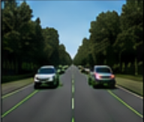
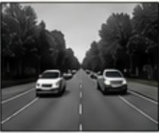
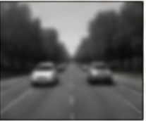
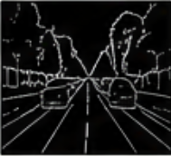



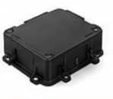






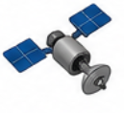



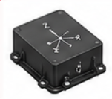
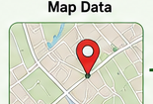
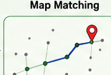
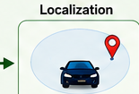






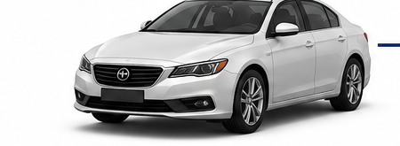
AUTONOMOUS VEHICLE PERCEPTION SYSTEM
INPUT SENSORS
PERCEPTION
PLANNING
Camera
1. IMAGE ACQUISITION & PREPROCESSING
Route Planning
(Images)
Input Image
Resize
Grayscale
Gaussian Blur
Edge Detection
Path Planning
LiDAR
(Point Cloud)
Obstacle Avoidance
2. PERCEPTION TASKS
Lane
Detection
Vehicle
Detection
Pedestrian
Detection
Traffic Sign
Detection
Traffic Light
Detection
Speed Planning
Radar
(Objects &
Velocity)
CONTROL
GPS
Steering
Controller
Speed
Controller
Brake
Controller
(Position)
LOCALIZATION
Map Data
Map Matching
Vehicle
Localization
IMU
Actuation Commands
(Steer, Accelerate, Brake)
Motion & Orientation
LEGEND
VEHICLE OUTPUT
Perception
Localization
Planning
Control
Lane
Keeping
Obstacle
Avoidance
Speed
Control
Traffic Sign &
Light Recognition
Safe
Navigation
Sensor Data Flow

Slide 3
Working of the Autonomous Vehicle Perception System
Uses multiple sensors to collect environmental data.
Camera, LiDAR, Radar, GPS, and IMU provide different information.
Images are pre-processed to improve quality.
Perception module detects lanes, vehicles, pedestrians, and traffic signs.
Localization identifies the vehicle's position.
Planning decides the safest route.
Control module executes steering, braking, and acceleration.
Final output ensures safe autonomous navigation.

Slide 4
Sensor Choice vs Real-Time Constraints
Sensor Choice
📷 Camera
Captures road images and traffic signs.
Sensitive to low-light conditions.
📡 LiDAR
Provides accurate 3D distance.
Expensive sensor.
📶 Radar
Works well in rain and fog.
Lower image resolution.
🛰 GPS + IMU
Provide location, speed, and vehicle orientation.
Improve localization accuracy.
Real-Time Constraints
High image quality improves detection but increases processing time.
Faster processing enables quick decisions but may reduce accuracy.
Sensor fusion improves reliability but requires more computational power.

Slide 5
Real-Time Constraint Trade-offs
Challenges
High-resolution images improve accuracy but increase processing time.
Camera performance decreases in low-light conditions.
LiDAR provides accurate depth but is expensive.
Radar performs well in bad weather but offers lower image detail.
Sensor fusion improves reliability but requires higher computation.
Conclusion
Multiple sensors improve perception accuracy.
Image preprocessing enhances object detection.
A balance between accuracy, speed, and cost is essential.
Autonomous vehicle perception enables safe and intelligent driving.

Slide 6
Thank You!

